Slide 1
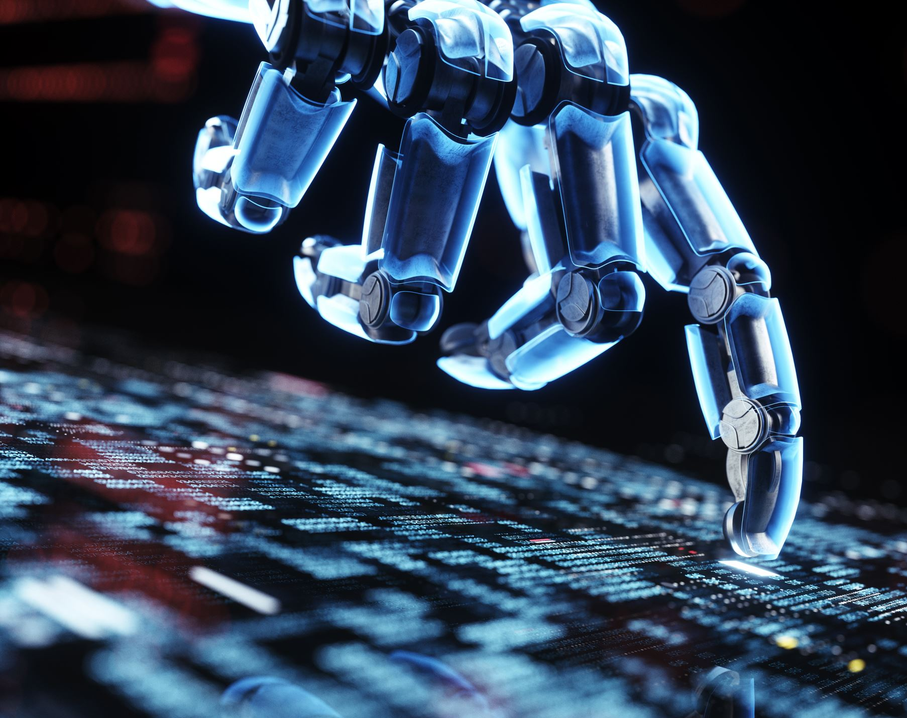
AI Deployment Environments and Requirements
Matthew Lima and Krishu Nakarmi
University of Rhode Island
ELE548: Computer Architecture

Slide 2

Agenda
Topic Description
Overview
Hardware and Software Setup
Testing Methodology
Evaluation Metrics
Questions
Related Works

Slide 3
Topic Description
Artificial Intelligence (AI) is a rapidly growing field of data science.
Utilizes Deep Neural Networks (DNN), which rely heavily on matrix-multiplication.
Current trend of moving AI inference from the cloud to the edge.
Different deployment environments can drive changes to the deployment platform.
Mobile environments tend to prioritize power efficiency, whereas data centers tend to prioritize accuracy and latency.
What factors are most important when deciding where to deploy an AI?

Slide 4
Overview
Goal: Create quantitative metrics for determining the best platform for deploying a DNN based on the deployment environment.
Evaluate the same DNN on multiple platforms and compare them against each other.
Use the results of the testing to create a benchmark for what environmental requirements would be satisfied by the best platform.

Slide 5
Setup
Hardware
Raspberry Pi 4B (8GB)
Windows Computer
Includes NVIDIA GPU for AI Acceleration
PYNQ-Z2 FPGA Development Board
Software
Python, C
Xilinx Vitis
YOLOv3-tiny Object Detection DNN
Windows
Linux

Slide 6
Testing Methodology
Run the same DNN (or as close as possible due to hardware constraints) on all platforms.
Run the same testing dataset through each platform.
Using the Common Objects in Context dataset for evaluation.
Popular for Object Recognition model comparisons.
Will run out of non-volatile storage rather than live images.
More varied data, less external factors, but could bottleneck overall execution time.

Slide 7
Evaluation Metrics
Accuracy
Should be very minor differences across all platforms.
May need to reduce the precision of the FPGA network due to hardware limitations.
Performance
How many operations per second each platform could achieve.
How long the entire calculation took.
Power Efficiency
Measured in performance per Watt.

Slide 8
Related Works
A. Boutros et al., “Beyond Peak Performance: Comparing the Real Performance of AI-Optimized FPGAs and GPUs,” in 2020 International Conference on Field-Programmable Technology (ICFPT), 2020, pp. 10–19. doi: 10.1109/ICFPT51103.2020.00011. Beyond Peak Performance: Comparing the Real Performance of AI-Optimized FPGAs and GPUs | IEEE Conference Publication | IEEE Xplore
J. Wang and S. Gu, “FPGA Implementation of Object Detection Accelerator Based on Vitis-AI,” in 2021 11th International Conference on Information Science and Technology (ICIST), 2021, pp. 571–577. doi: 10.1109/ICIST52614.2021.9440554. FPGA Implementation of Object Detection Accelerator Based on Vitis-AI | IEEE Conference Publication | IEEE Xplore
F. Al-Ali, T. D. Gamage, H. W. Nanayakkara, F. Mehdipour, and S. K. Ray, “Novel Casestudy and Benchmarking of AlexNet for Edge AI: From CPU and GPU to FPGA,” in 2020 IEEE Canadian Conference on Electrical and Computer Engineering (CCECE), 2020, pp. 1–4. doi: 10.1109/CCECE47787.2020.9255739. Novel Casestudy and Benchmarking of AlexNet for Edge AI: From CPU and GPU to FPGA | IEEE Conference Publication | IEEE Xplore

Slide 9
Questions?

